Slide 1

Tools for On-site Measurement Radio Interference Campaigns for P1451.5p
Jing Geng Industrial Wireless Systems Smart Connected Systems Division

Slide 2
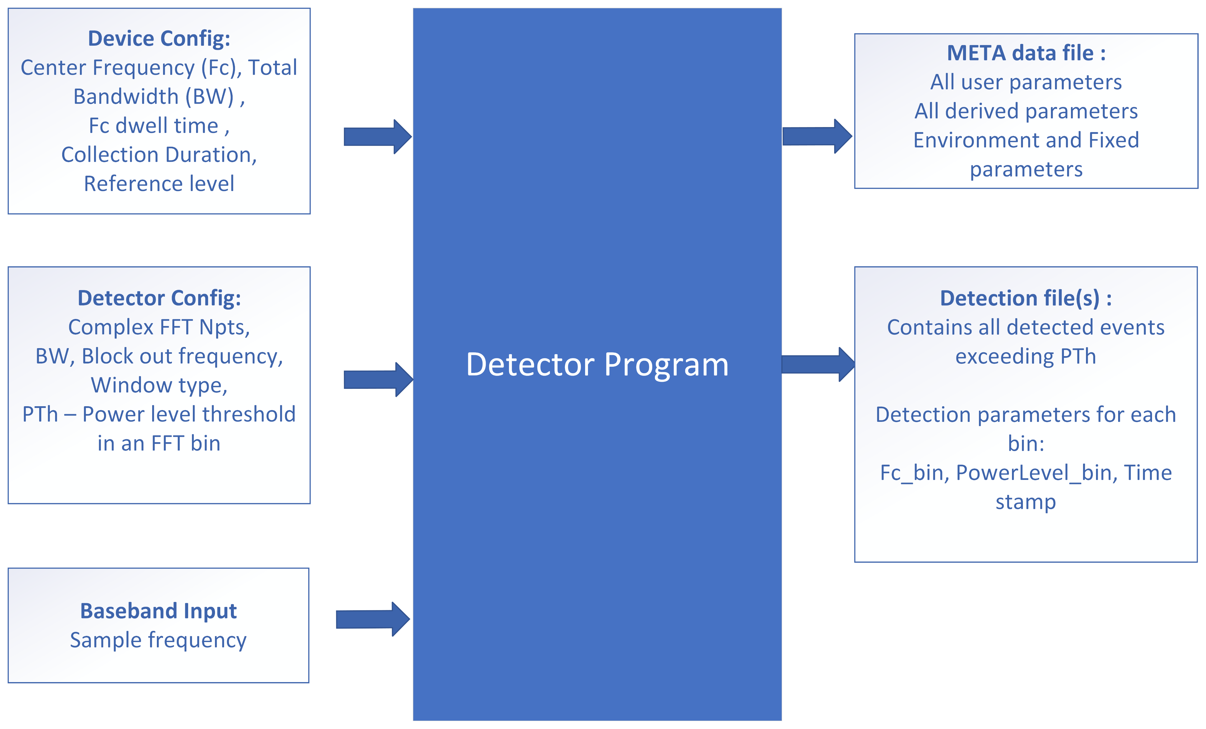
Requirements for Spectrum Detector
Notes:
Hope to measure what activities and interference in the interested spectrum
So we could emulate or recreate in a SDR

Slide 3
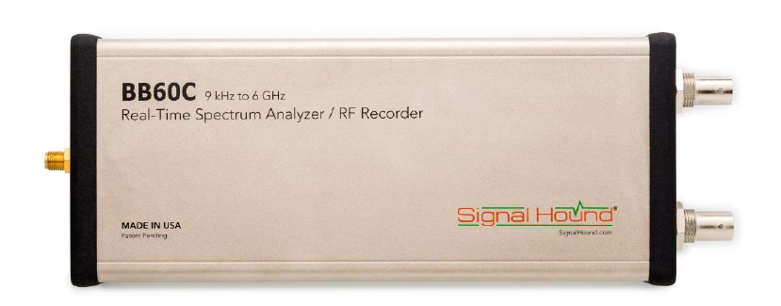
Wireless Event Capturing Approach
Basic spectrum analysis :
Sweep through certain spectrum band, max_hold/average through the capture trace
Interference hunting through spectrum device :
Device we test on : BB60C spectrum analyzer
9kHz to 6GHz
27 MHz max real-time bandwidth
Max 40M/s sample rate
Notes:
Test with bb60c to see the best possible detail it could capture based on this device

Slide 4
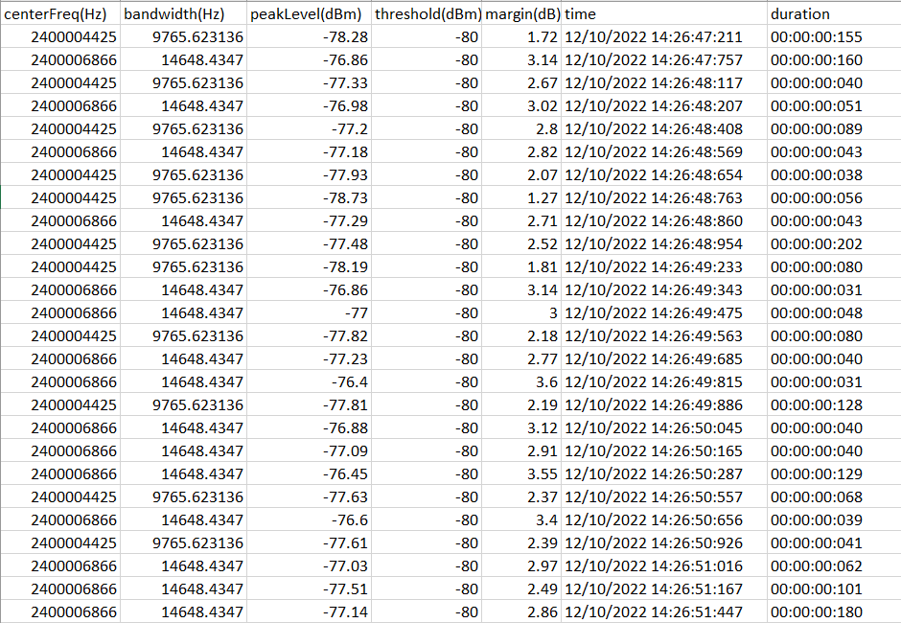
Detection Output from BB60C

Slide 5
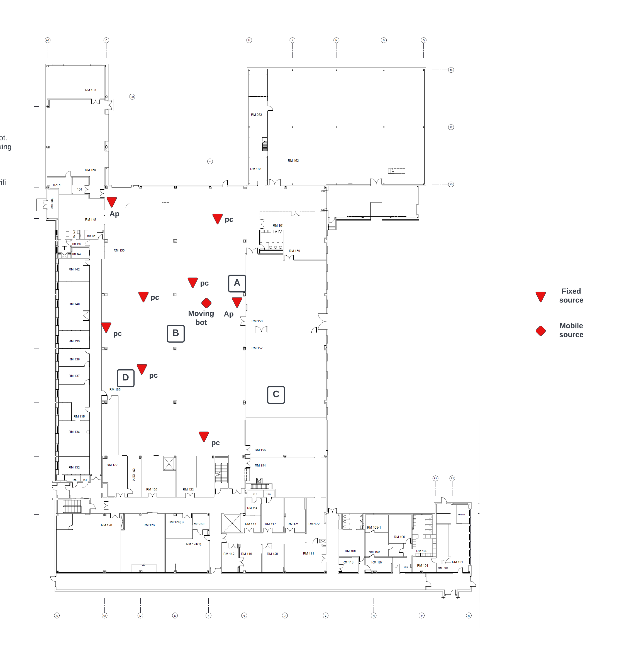
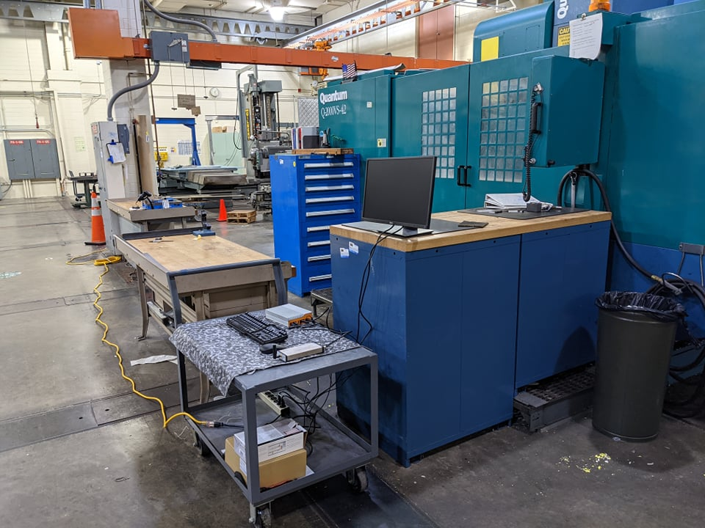
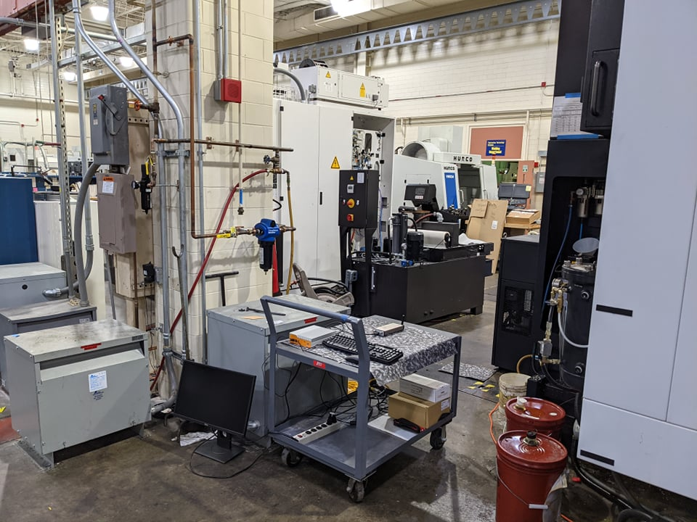
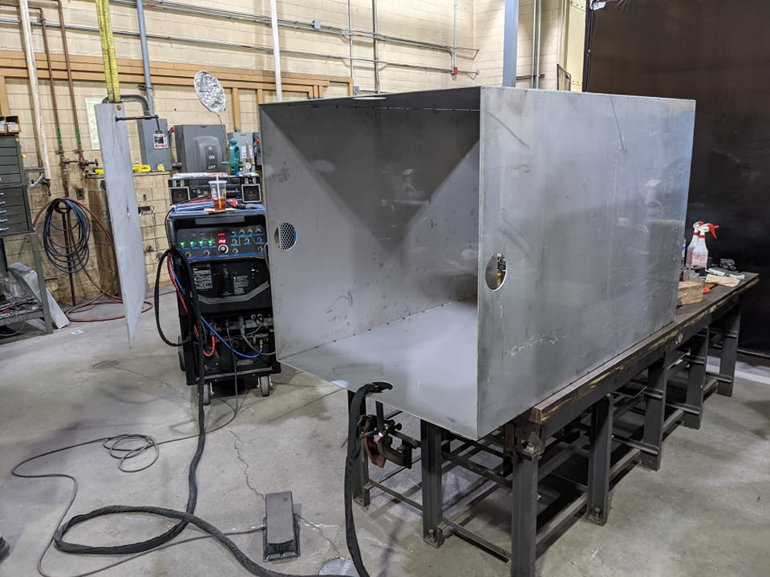
NIST Machine Shop Measuring
A space with large machines (for welding, milling, lathe work, etc), cranes and tools, workbenches, computers.
Outer dimensions of approximately 12 m x 15 m (40 ft x 50 ft) and a ceiling height of approximately 7.6 m (25 ft)
Possible sources and interference :
Wi-Fi aps, PCs
Personal cell phones
Wireless control crane
Machine noise
Mobile crane

Slide 6
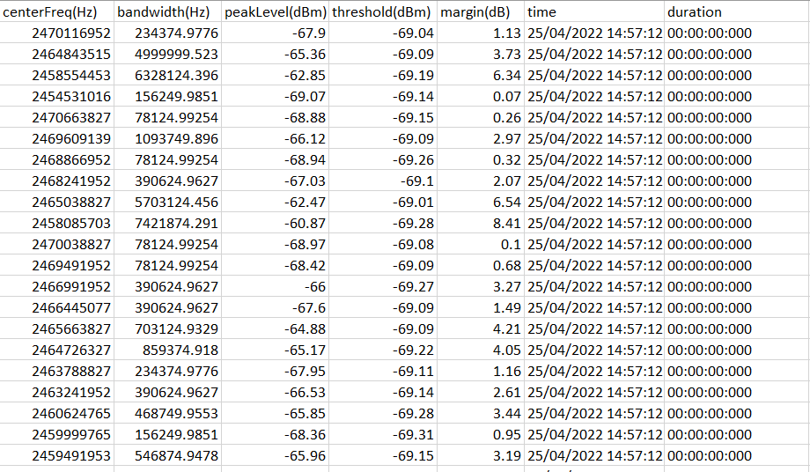
Limitations
Limitation on min event captured
Unstable event capturing for periodic signals
Hardware limitation (sweep speed)

Slide 7
Directly IQ Capturing (1)
Sweeping over the interested band with real-time bandwidth.
IQ data capturing, process, threshold, and write to events.
Limitations : (Capturing input 160 MB/s)
Software processing speed
Memory space limitation (~9.2GB per min.)
Solutions :
Software base acceleration (e.g. GPU, better PC)
Hardware solution

Slide 8
Directly IQ Capturing (2)
Zero span recording, threshold, write event :
Narrowing down a smaller bandwidth for each capturing.
Sweep and hop around the total interested band
Calculate only the IQ power and do thresholding
Much faster and can be implemented real time

Slide 9
Other Requirements
Min event duration
How detail should the measurement be to characterize in different scenarios.
Others?
Notes:
1 Is it necessary to have the detector capable of detecting in such a small event
2 scenarios (like process control scenarios, scenarios with noises with microwaves, or even other wifi network. Different scenarios have different packet size and transmission datarate)
make the requirement for different scenarios based on device capability

Slide 10
Possible sites :
NIST (NIST shop, steam plant)
Concrete plant, LaFargeHolcim – William Miller
The J. J. Pickle Research Campus (PRC) in Austin – Juan Conchas
Intel Casper Site – Javier
Boeing – Michael Greene
Office in Spain– Inaki
Small factory in Spain – Inaki
Outdoor space (Woodyard at paper mild) – Scott McNeil
Phoenix contact – Justin shade
GM General motors
Small-medium sized factories target
Ford plant

Slide 11
Summary
Basic requirements for the tool for on-site measurement radio interference.
Different approaches with different limitations.
The result can help in better knowing the spectrum activities, interference patterns in different capturing environments.
Cannot replace the basic analysis for existing protocols, devices, and possibilities.
Notes:
Advantage : large span of bw sweep
Limiation : hardware

